Slide 1
Spread of Rice Cultivation
CMPS 4553 Project
By: Joshua Allen and Yujin Yoshimura

Slide 2
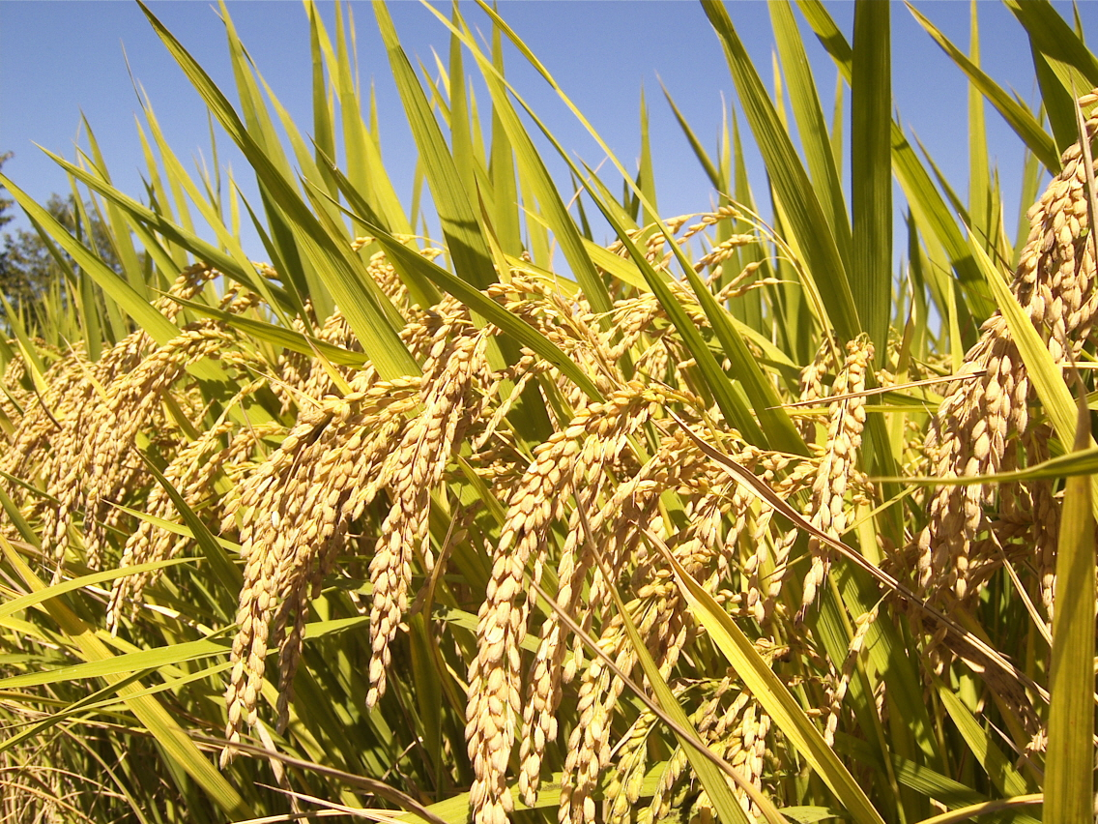

Slide 3
Why Rice?
Rice is a crop that:
Is widely used in many cultures, particularly those of the Asian continent.
Has a large crop yield per unit area compared to other grains.
When grown in paddies, can be planted continuously without degrading the soil.

Slide 4
Crop yield per acre comparison
Rice | 736 000 | lbs per acre
Potato | 39 500 | lbs per acre
Onion | 17 640 | lbs per acre
Corn | 7 168 | lbs per acre
Winter Wheat | 1 920 | lbs per acre
Soybeans | 1 860 | lbs per acre

Slide 5
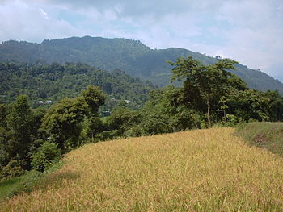
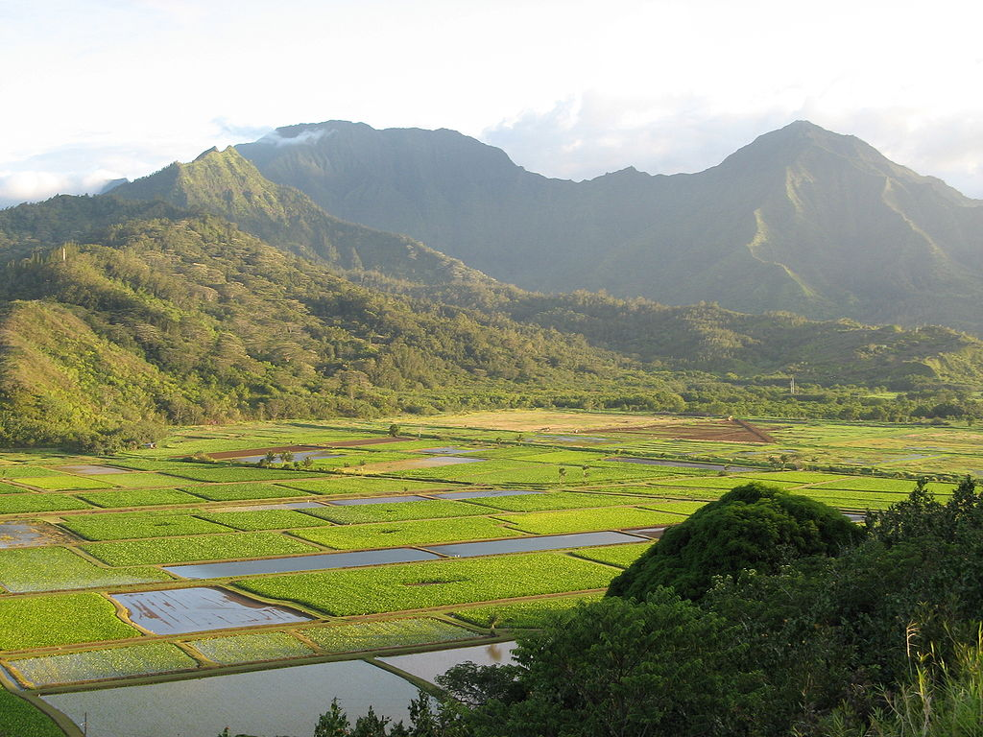
Upland Rice vs. Paddy Field

Slide 6
Replant Failure
Monocropping gradually depletes certain nutrients from soil, and attracts pathogens.
Also known as sick soil syndrome.
Crop rotation is practiced to avoid replant failure.
Rice cultivated in paddy field does not experience replant failure, because flood balances nutrients and pathogens cannot survive in flood.

Slide 7
Problems with Rice
Rice is a very needy crop. Rice requires:
A large amount of water to be cultivated.
A technology of irrigation.
A particularly warm climate to be cultivated.

Slide 8
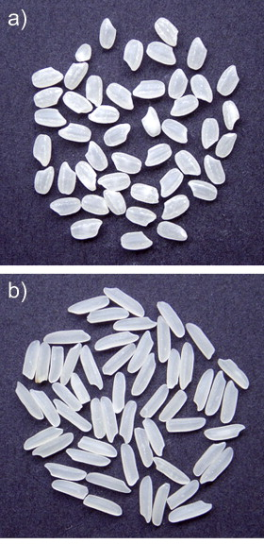
Genetic subspecies
Japonica Rice: Starch contains less amylose. Sticky. Grown in subtropical to temperate climate.
Indica Rice: Starch contains high amylose. Not sticky. Grown in tropical climate.

Slide 9
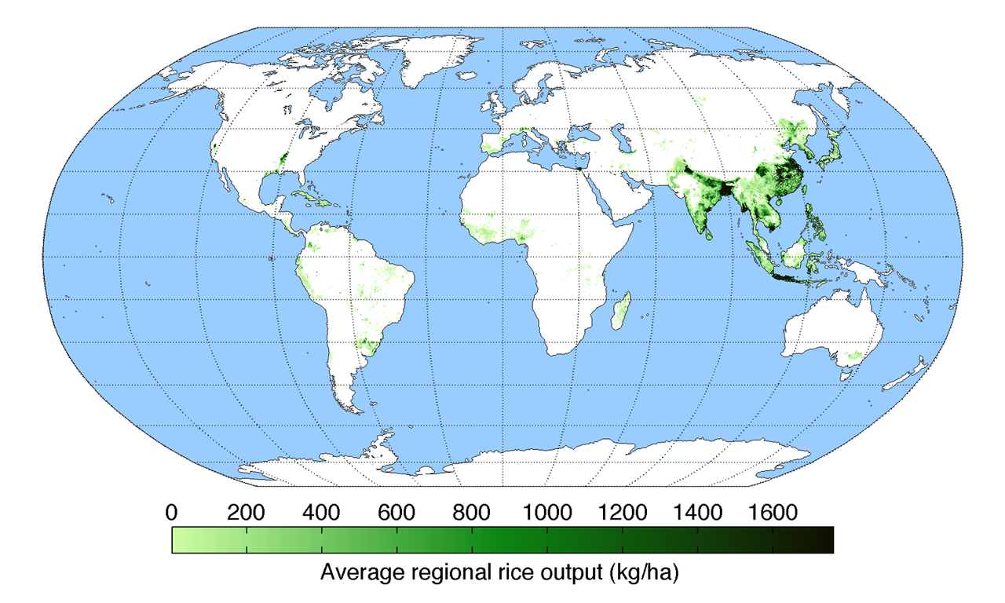
Rice production in World

Slide 10
Origin of rice cultivation
Wild rice: Oryza glaberrima
Domesticated rice: Oryza sativa
First domesticated rice was found in Pearl river valley in China
Rice cultivation began approximately 10 000 - 15 000 years ago, in Yangtze river valley in China

Slide 11
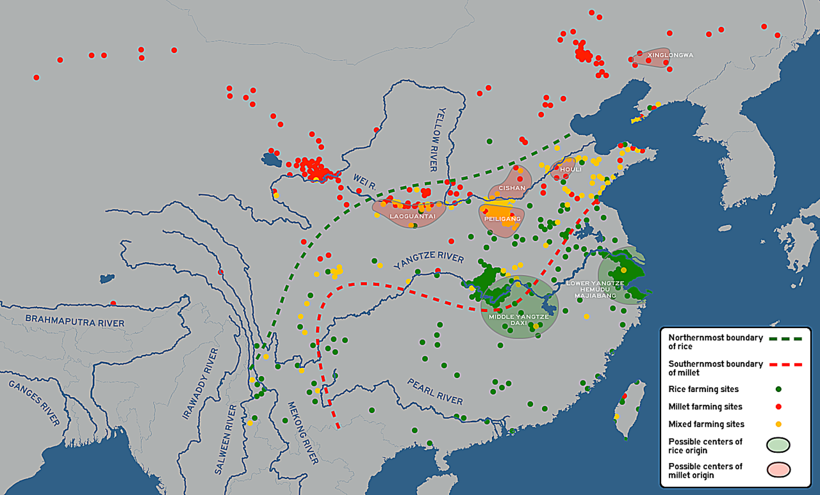
Origin of rice cultivation

Slide 12
Unique attributes of the Code
NetLogo allows the size of the world to be made of any number of patches.
NetLogo has well written extensions that allow for CSV files to be easily read and imported .

Slide 13
References
Ricepedia
World Bank Data
NOAA Climate.gov
Thematic maps and city maps Climate - mAPPedplanet
Crop Yield Verification - The Garden of Eden Project
Texas Almanac - Texas Crop Production
Science Direct - Food Research International

